Slide 1
Autonomous Robot using Computer Vision
Presented by
Aditya Godambe
Ashutosh Mahajan
Chinmay Karanjkar
BE Computer, KJSCE

Slide 2
Introduction
Autonomous Machines – The Present and the Future
Human Machine Interaction
Technologies used in Autonomous Machines.
Existing Technologies

Slide 3
Current scenario
Description about current autonomous vehicle technology status
Google’s driverless cars (WAYMO)
Current technologies used to detect surroundings

Slide 4
Autonomous Robot using Computer Vision
Why ARCV?
Features
Signal Detection
Obstacle Detection
Navigation

Slide 5
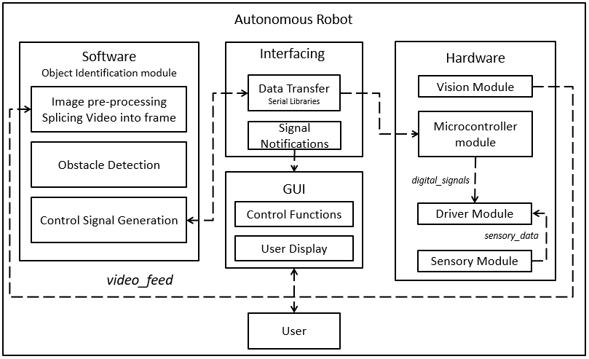
System Architecture

Slide 6
Hardware core
Importance of Hardware
Major Components and their significance
Processing Units (Processor, Microcontroller)
Vision Unit
Driving Unit
Chassis Unit

Slide 7
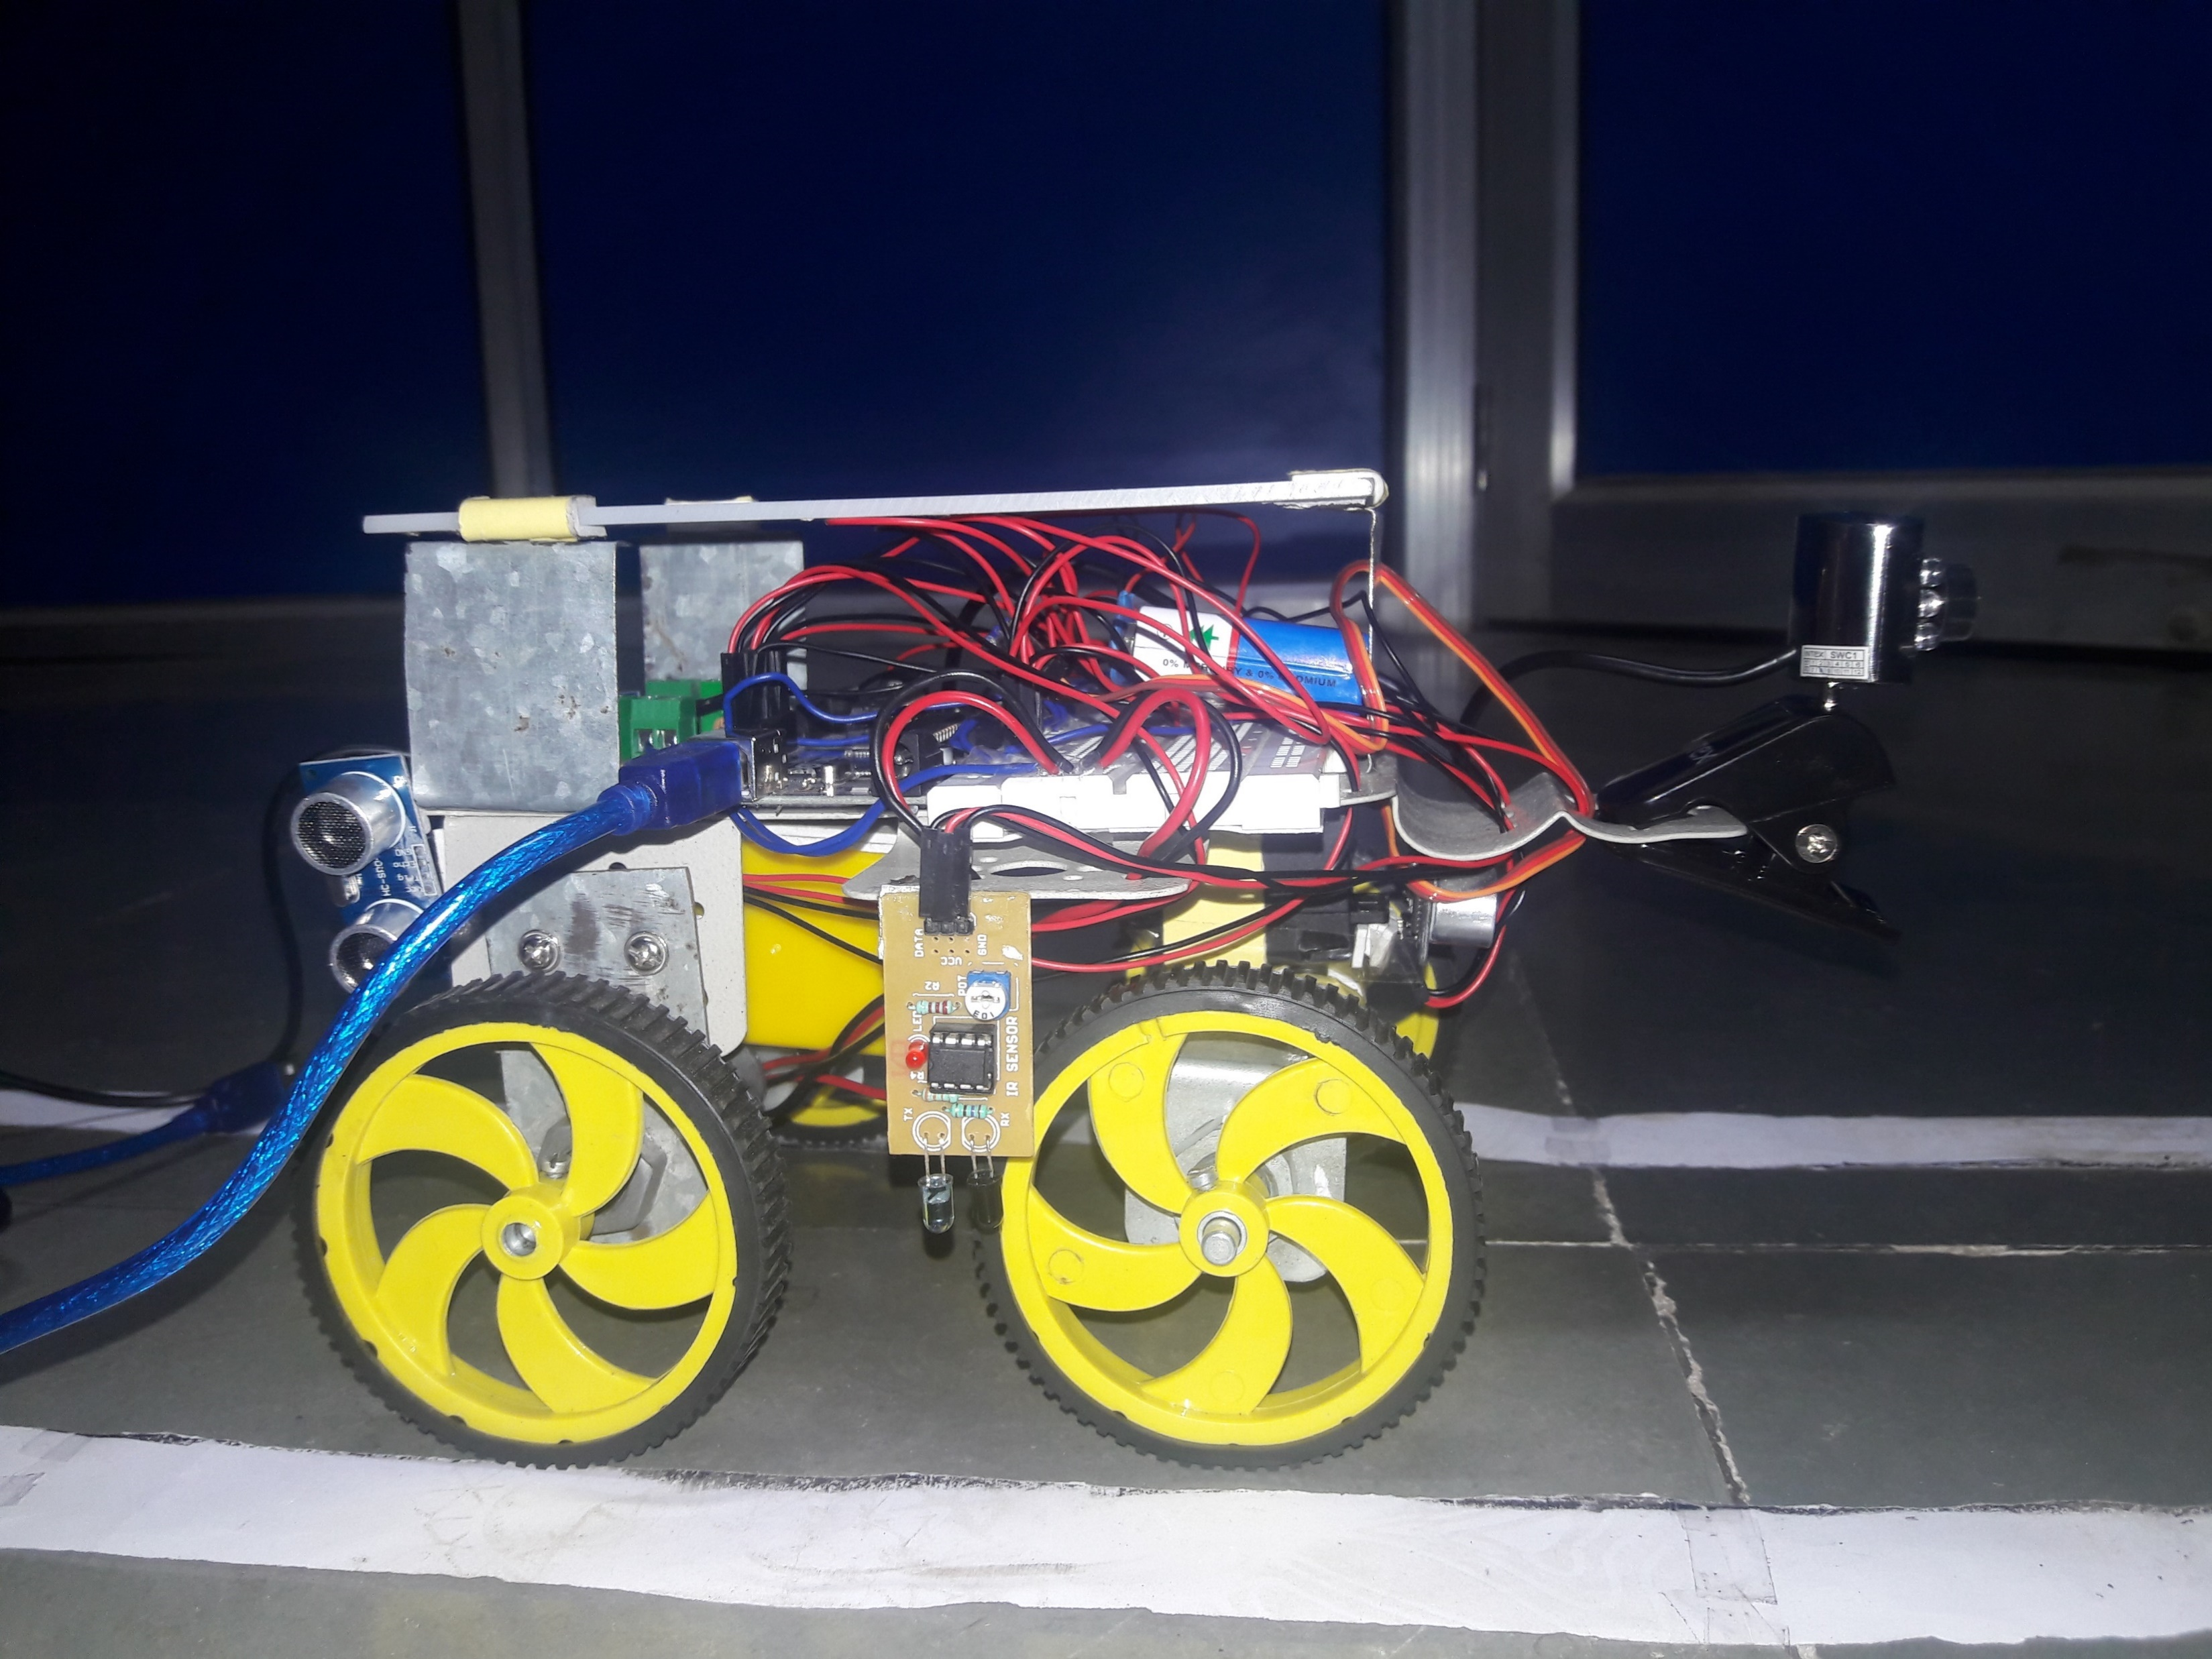
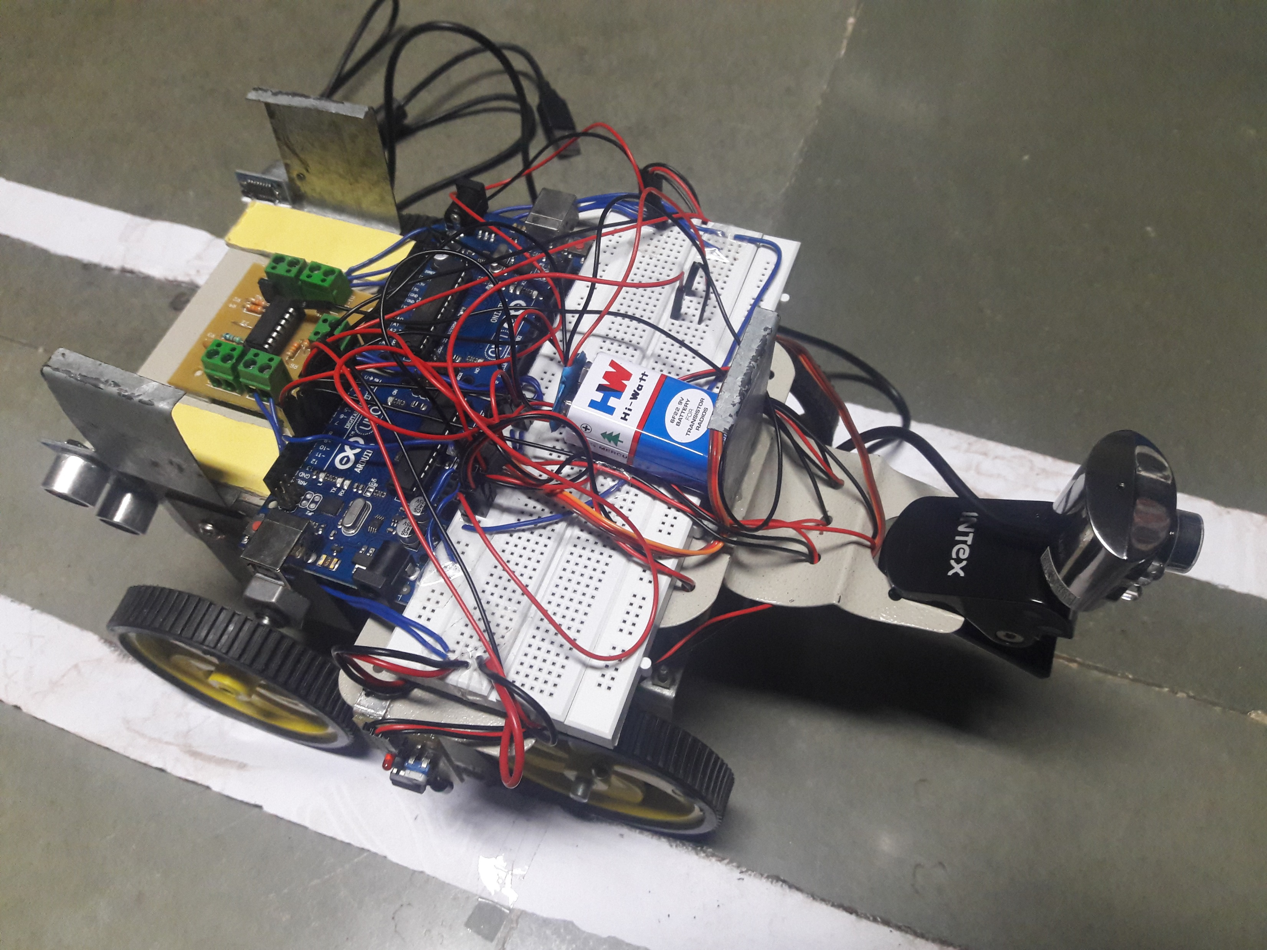
Prototype Model(Hardware Backbone or Hardware layer)
Side View
Top View

Slide 8
Software core
Signal detection Module
Navigation
Obstacle Identification and Categorization

Slide 9
OBSTACLE Identification and Categorization
What it does?
Image Pre-processing
Analyses each frame spliced from the video feed
Obstacle detection
Training and testing of the classification function using pre-defined dataset
Identification of the obstacle using the classification function
Control signal generation

Slide 10
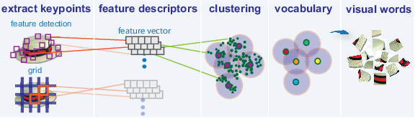
Generation of feature descriptors

Slide 11
Interfacing
Arduino IDE Serial libraries
MATLAB
Communication between Hardware and Software
Flow of Control

Slide 12
GUI

Slide 13
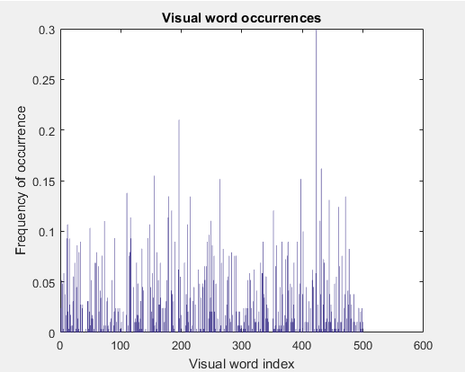
Experimental results
Histogram
Measure of Visual Words
Accuracy of Training – 0.73
Accuracy of Testing – 0.64
Experimental Test of 45 images
Error of 20% for 4 categories of data.

Slide 14
Application and Future Scope
Application
Military Surveillance
Driverless Cars
Future Scope
GPS Navigation
Stand-alone Processor
Improved Efficiency – Time and Processing

Slide 15
Conclusion

Slide 16
References

Slide 17
Thank You!

